Slide 1

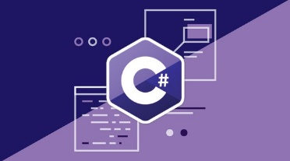
Programming Fundamentals – Course Program
Course Introduction – Course Program, Trainers, Exams, Resources
C# Intro and Basic Syntax
C# Conditional Statements and Loops
Data Types – Numeral Types and Type Conversion
Methods and Debugging – Finding and Fixing Bugs in Programs
Arrays – Simple Array Processing
Lists – Processing Variable Length Sequences
Array and List Algorithms

Slide 2
Programming Fundamentals – Course Program (2)
Dictionaries – Associative Arrays
Advanced Dictionaries – Multi-Dictionaries, Nested Dictionaries
Lambda and LINQ – Collections and Queries
Objects and Simple Classes – Using Objects and Classes, and Defining Them
Files, Directories, Exceptions – Working With the File System and Handling Exceptions
Strings and Text Processing – Processing and Manipulating Text
Regular Expressions – Modern Text Processing
Exam Preparation – Practical Exam Problems (3 times)
Practical Exam – 4 Problems for 6 Hours

Slide 3

Tech Module @ SoftUni
4 Months Technology Fundamentals Training

Slide 4

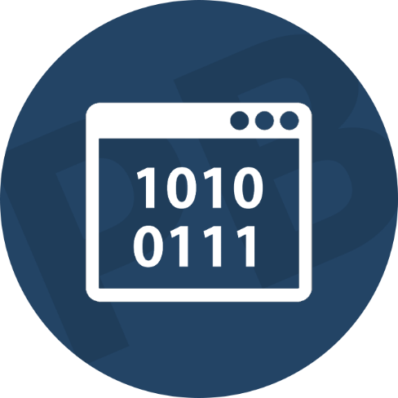

Tech Module Goals
Programming Fundamentals – Extended
4 months programming fundamentals training
3 times weekly, lots of live coding and exercises

Slide 5
Tech Module Goals
Technology Fundamentals
Part I – Programming Fundamentals
Arrays, lists, dictionaries, LINQ, objects, files, strings, regular expressions, …
Part II – Software Technologies
Get acquainted with the most popular technologies out today
PHP Web, JavaScript Web, Java Web, C# Web

Slide 6
Tech Module (Extended) at SoftUni – Timeline
22-May-2017
Aug-2017
Sept-2017
Oct-2017
Nov-2017
Programming Fundamentals Extended
Lessons + exercises + exam
12 weeks * 3 times / week
6 credits
Start: 22-May-2017
Final exam: 20-Aug-2017
Programming Fundamentals Re-Take Exams
First week of Sept-2017
Programming Fundamentals
Lessons + exercises + exam
7 weeks * 5 times / week
6 credits
Start: September 2017
Final exam: October 2017
Software Technologies
Lessons + exercises + team work project
5 weeks * 5 times / week
12 credits
Start: October 2017
Final Exam: November 2017

Slide 7
Professions @ SoftUni
Programming Basics
Java
Fund.
Java
DB
Java
Web
JS Core
C#
Fund.
C#
DB
C#
Web
JS Core
Programming Fundamentals Extended
Tech Module
JS Core
MEAN
Stack
Web
Basics
PHP
Web
Web
Basics
JS Core
https://softuni.bg/curriculum
https://softuni.bg/trainings/courses

Slide 8
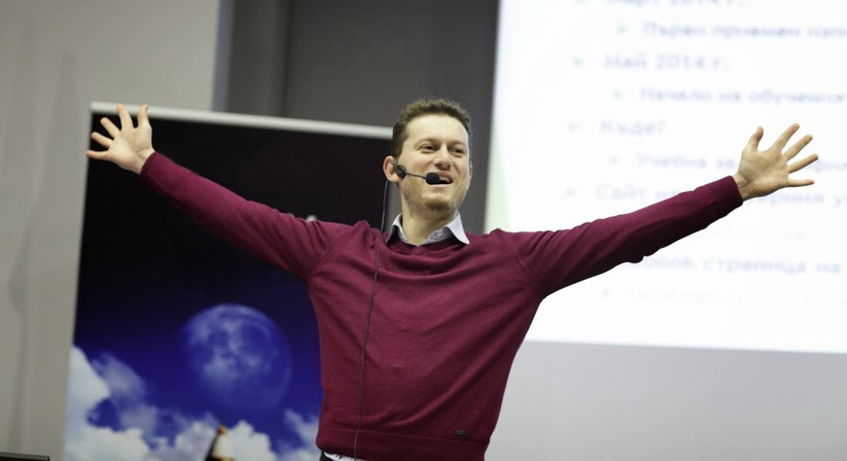
The Trainers Team

Slide 9
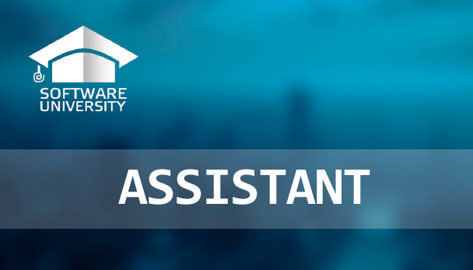
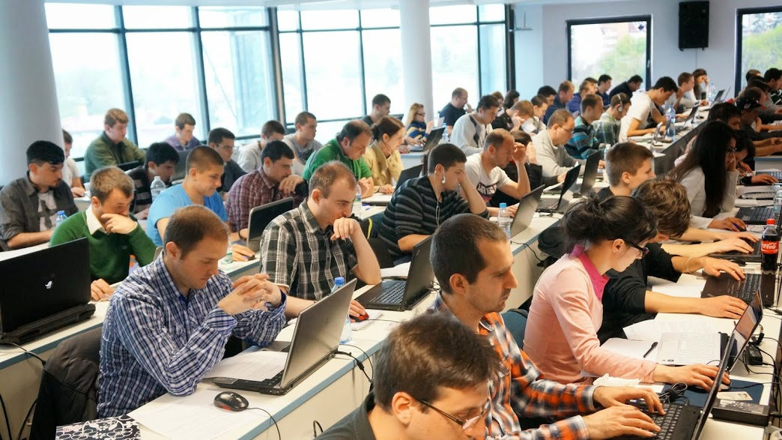
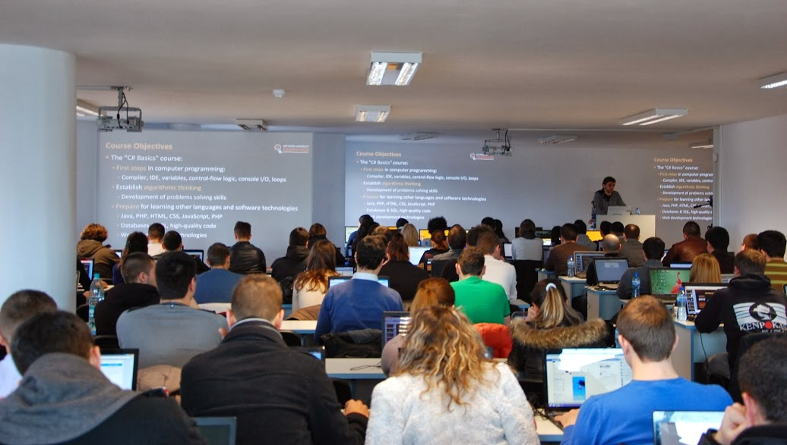
Teaching Assistants
Teaching assistants
Scholarship top students from SoftUni
Yanitsa Valeva, Radoslav Evgeniev

Slide 10


Scoring System for “Programming Fundamentals”
Exam – 90%
Homework (exercises) – 10%
Bonuses: up to 10%
Presence in class: 5% (onsite students only)
Forum activities
Others

Slide 11
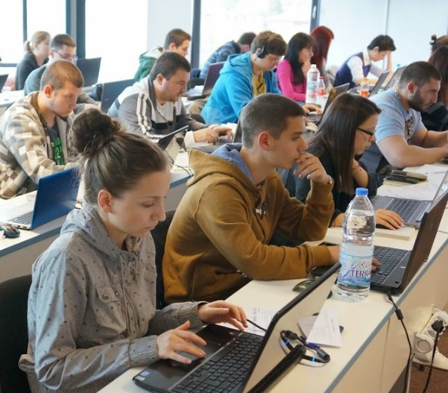

Programming Fundamentals Exam
Practical programming exam
4 practical problems for 6 hours
Simple arrays, lists, dictionaries, strings
Code in C# (Java, PHP, JS are also welcome)
Automated judge system
http://judge.softuni.bg
Solutions are evaluated for correctness only
Code quality is still not measured

Slide 12

Homework Assignments
Doing your homework is very important!
Programming can only be learned through a lot of practice!
You should write code every day!
Each lecture is followed by many exercises
Try to solve them in class
The rest are your homework
Homework assignments are due in 6 days after each lecture
Submission through our online judge system: judge.softuni.bg

Slide 13
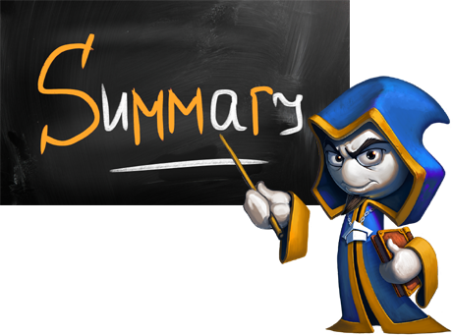

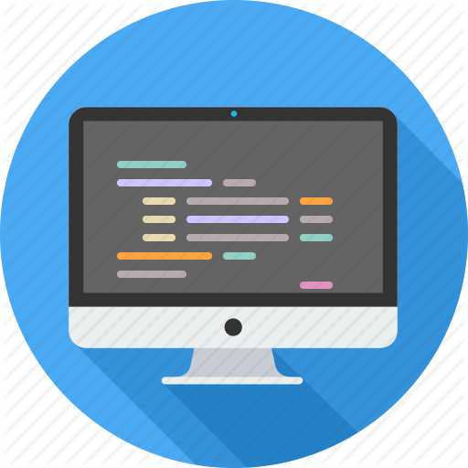

Summary
Training program
Data types, methods, debugging, arrays and lists, dictionaries, objects, strings and much more
Practical exam
4 problems for 6 hours
Learning resources
Slides, videos, software, books, forum

